Slide 1


Slide 2
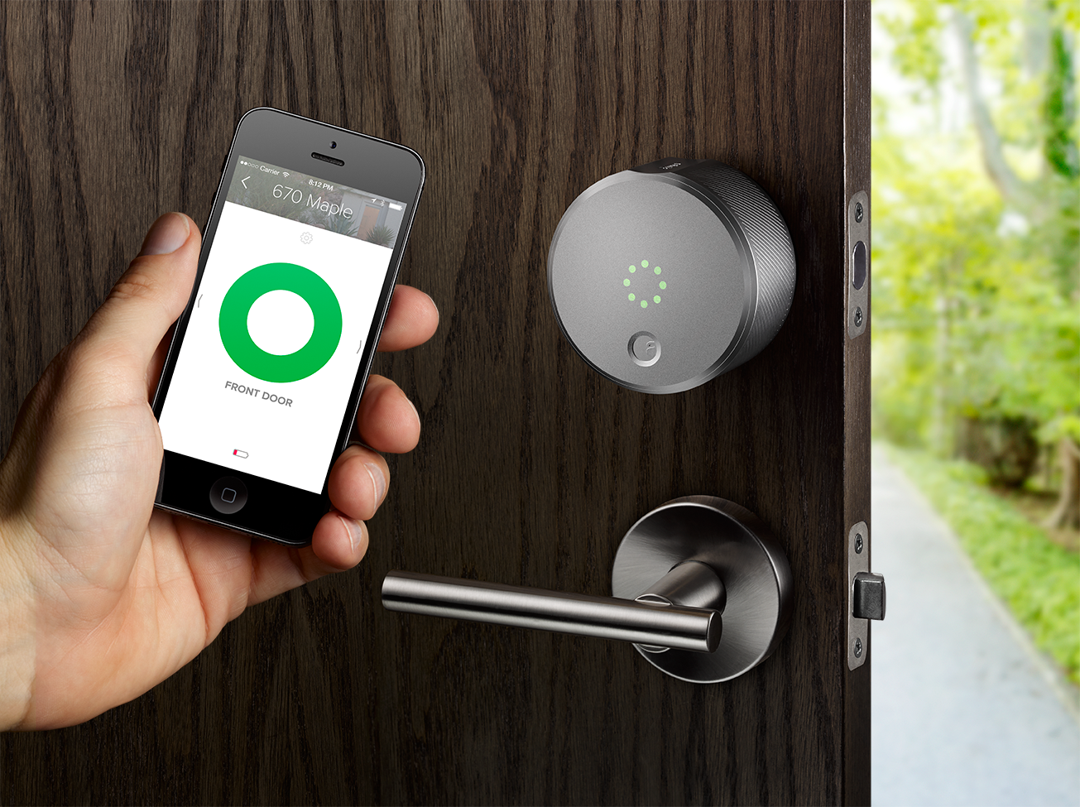
Intelligent Door Access Management System

Slide 3
Project Description
This project will create a smart doorbell notification system so that when a guest clicks on the button, obtains an image of the user via a camera peripheral, and uploads the image and event data to a Googles Firebase cloud and sends a notification with some message to notify that a guest has arrived.
So from that app we can view who is at the door and we can open and close the door by using the mobile application. By using this system you can know who are knocking your door through the application no matter where you are.
We can flash the Android Things in the Raspberry Pi and access the GPIO pins of Raspberry pi through android programming.

Slide 5
PROJECT HIGHLIGHTS
Interfacing Camera and Push button with Raspberry pi.
Controlling the door through mobile Application.
Capturing the image at device and sending to Mobile App Through Google’s Firebase Cloud platform.

Slide 6
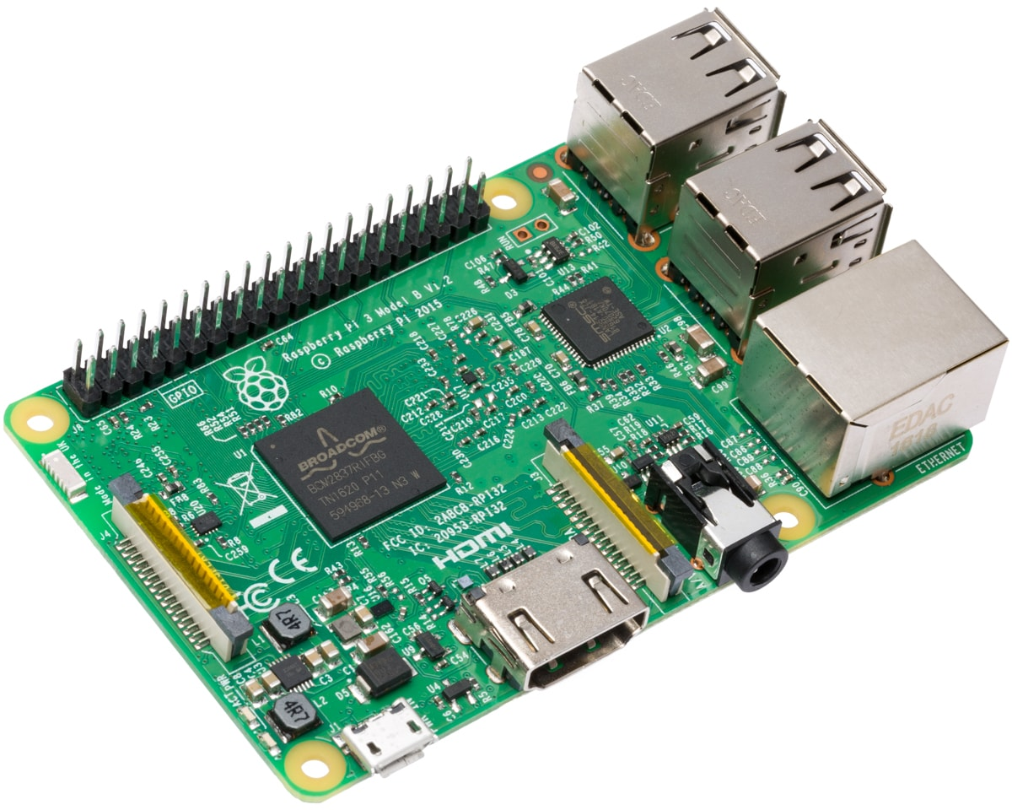
RASPBERRY PI 3 B
The Raspberry Pi is a low cost, credit-card sized computer that plugs into a computer monitor or TV, and uses a standard keyboard and mouse.
It is a capable little device that enables people of all ages to explore computing, and to learn how to program in languages like Scratch and Python.
It’s capable of doing everything you’d expect a desktop computer to do, from browsing the internet and playing high-definition video, to making spreadsheets, word-processing, and playing games.
What’s more, the Raspberry Pi has the ability to interact with the outside world, and has been used in a wide array of digital maker projects, from music machines and parent detectors to weather stations and tweeting birdhouses with infra-red cameras.
We want to see the Raspberry Pi being used by kids all over the world to learn to program and understand how computers work.

Slide 7
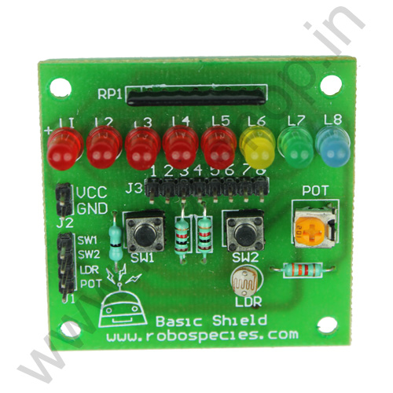
BASIC SHIELD
The Basic Shield can be interface with 5V or 3.3V logic microcontroller boards like Arduino,AVR, PIC, ARM etc.
Basic Shield is very popular shield for interfacing of electronics component with microcontroller like LED’s, variable resistor, Push Button, LDR, buzzer etc.
All components are arranged in a proper manner so that you can use it with your microcontroller to learn basic programming of microcontroller in your projects. This shield helps you how to deal with basic electronics component in your project.
It contains:
8 LEDs (5 mm)
4 Push Button
2 Potentiometer (102k)
LDR (light detection resistor)
Buzzer

Slide 8
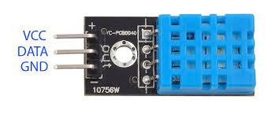
DHT11 SENSOR
DHT11 Temperature and Humidity Sensor features a calibrated digital signal output with the temperature and humidity sensor capability.
It is integrated with a high-performance 8-bit microcontroller. Its technology ensures the high reliability and excellent long-term stability.
Operating Voltage: 3.5V to 5.5V
Operating current: 0.3mA (measuring) 60uA (standby)
Output: Serial data
Temperature Range: 0°C to 50°C
Humidity Range: 20% to 90%
Resolution: Temperature and Humidity both are 16-bit
Accuracy: ±1°C and ±1%
The DHT11 sensor can either be purchased as a sensor or as a module. Either way, the performance of the sensor is same.
The DHT11 is a commonly used Temperature and humidity sensor.
Applications:
Measure temperature and humidity
Local Weather station
Automatic climate control
Environment monitoring

Slide 9

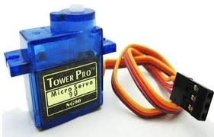
SERVO MOTOR
A servo motor is an electrical device which can push or rotate an object with great precision. If you want to rotate and object at some specific angles or distance, then you use servo motor. It is just made up of simple motor which run through servo mechanism
It consists of three parts:
Controlled device
Output sensor
Feedback system
A servo consists of a Motor (DC or AC), a potentiometer, gear assembly and a controlling circuit.
First of all we use gear assembly to reduce RPM and to increase torque of motor.
Servo motor is controlled by PWM (Pulse with Modulation)

Slide 10
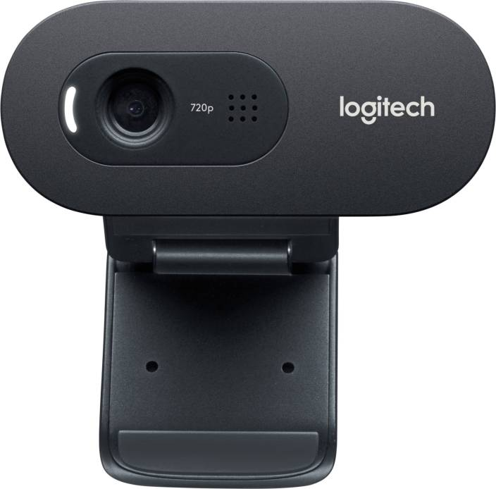
LOGITECH CAMERA
Install fswebcam.
Basic image capturing usage.
Set specify a resolution.
Set full a resolution with no banner.
Bash script.
Python with Bash script.
Time lapse using CRON.

Slide 11


